Slide 1
Advanced SQL Reinforcement Project
IMDB Data set
Presented By,
Arjun.M
March 2025 batch

Slide 2
Data Set – IMDB introduction A simplified version of the IMDB database designed for SQL learning and analysis. It contains information on movies, ratings, people involved (actors, directors), genres, rating , country , year of releasing and more … Project Overview Analyze the data set and get the meaningfull outcome.

Slide 3
SQL Overview SQL Queries used in this project Join – Connecting Different table types (Left join, Right Join, Inner Join, Self Join) Where - used to filter records in a SQL statement, allowing you to specify conditions that must be met Like - It supports two wildcard characters: % matches any sequence of characters, and _ matches a single character

Slide 4
Table overview
Movie
Genre
Names
Ratings
Contains metadata about movies. Each row is a unique movie. Title, Year, Duration, Country, Language, Income…
Associates each movie with one or more genres like Crime, Drama, Horror, Mistry, Action, Comedy
Information about individuals like Actor, Actress, Director
Stores user rating metrics for each movie like Average rating, Total Votes, Median Rating

Slide 5
Top 10 movies bassed on Ratings

Slide 6
Top 5 movies with highest total votes

Slide 7
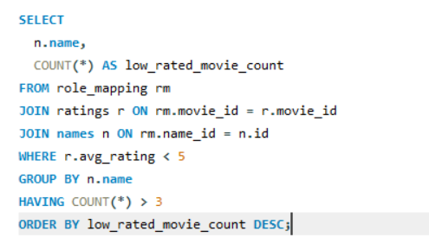
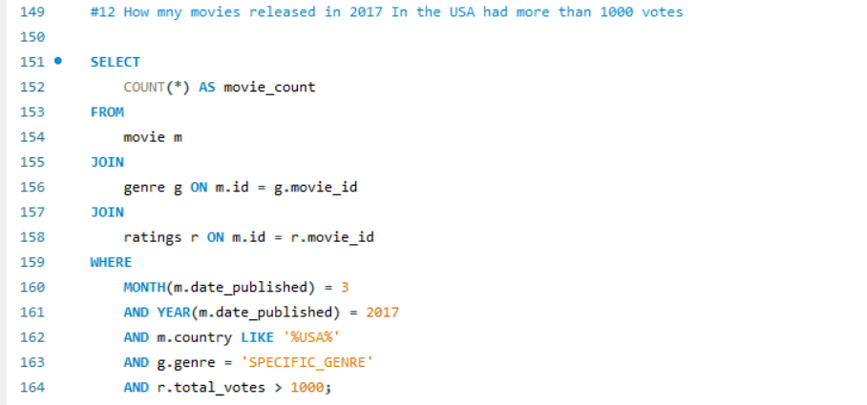
Join Operator Used to combine Data from one or more tables.

Slide 8
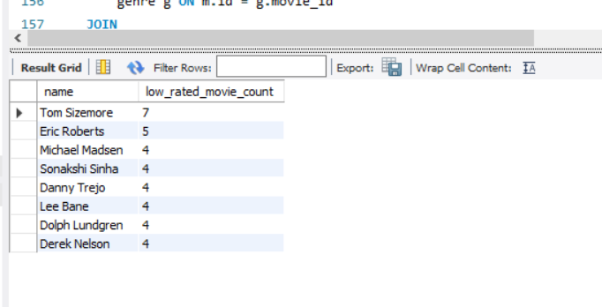
Where condition used to filter records in a SQL statement, allowing you to specify conditions that must be met

Slide 9
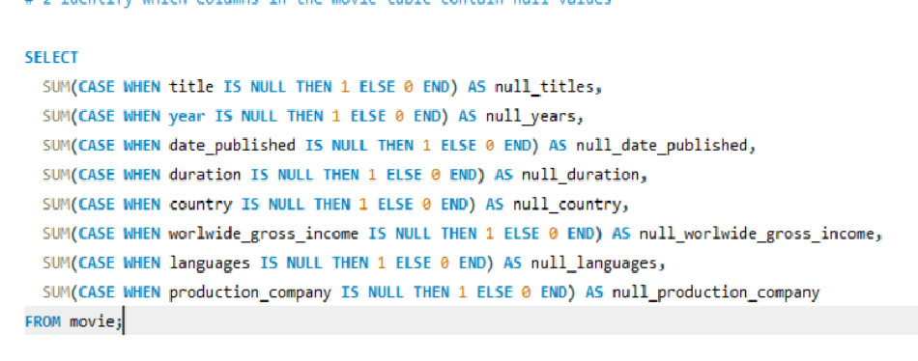
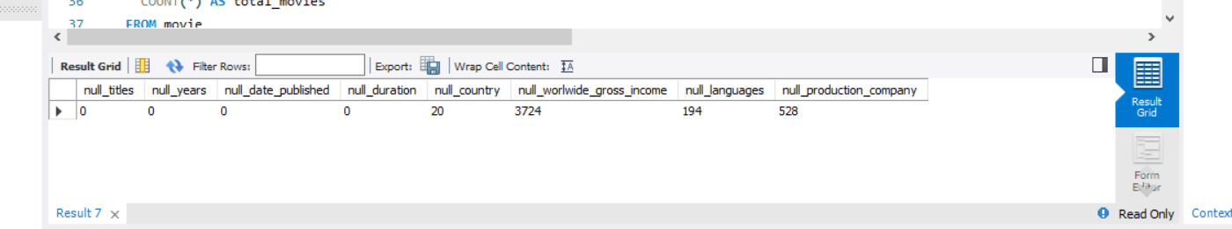
Grouping and Filtering Where class I used to find the Null Values

Slide 10
Conclusions This project demonstrates the versatility and power of MySQL as a database management system (DBMS) for managing and manipulating data.

Slide 11
Thank You Any Questions

